Slide 1
INFSCI 1073/ TELCOM 2727 Spring 2014
Instructor: Jay Palat
412-423-8177
vpalat@pitt.edu
TA: Velin Kounev
vkounev@pitt.edu

Slide 2
Rules of the Road
T-Th 1:00 – 2:15
Room: IS 405
Resources
Required Text: Jeremy Keith. HTML5 for Web Designers: A Book Apart by Jeffery Zelchmann; 1st edition ISBN-10: 0984442502; ISBN-13: 978-0984442508. Required.
Additional resources will be linked in

Slide 3
Goals of the Course
Write iOS Applications
Write HTML5
Understand which technology makes sense for the occasion
Learn/Discuss mobile apps
Issues of mobile and where we’re going

Slide 4
Approach
Mainly Project Based
Majority in iOS
Real-World App focus

Slide 5
iOS
Xcode, Apple and the walled garden
Objective-C
User Interfaces
1st & 3rd Party Frameworks
Playing well with others: Sharing, internet, Usability and Security

Slide 6
HTML5 Topics
Basics of HTML5
Responsive Design
Native vs HTML5? Which is better?

Slide 7
Course Overview
Tentative List of iOS Projects
Hello World!
Sharing – internet, social media
Sensing – location, camera
Offline storage and Persistance

Slide 8
Who am I?
Software Engineering Lead for UPMC
Native vs HTML5?
Startups to Enterprise

Slide 9
Who are you? Survey!
Stack
Mobile
Java
Database
Git
Macs/OSX
iOS
Android
Something else?

Slide 10
Mobile

Slide 11
A brief history
1991 Digital Cellular Phones
Short Message Service 1992
Blackberrry – (90’s, popular early 2000’s)
iPod & iTunes – 2001
Sidekick (hiptop) - 2002
iPhone – 2007
Android – 2007
iPad -2010
Android 2.2 - 2010
Android 4.4 - 2013
iOS7 - 2013

Slide 12
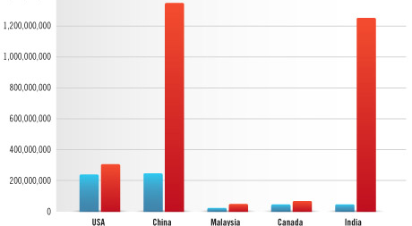
Room to Grow
http://blog.flurry.com/bid/97962/India-China-and-the-Map-to-Two-Billion-Connected-Devices

Slide 13
Questions?

Slide 14
INFSCI 1073/ TELCOM 2727 Spring 2014
Instructor: Jay Palat
412-423-8177
vpalat@pitt.edu
TA: Velin Kounev
vkounev@pitt.edu

